Slide 1
Save The Red Lion
Share offer November 2021
Buy the Red Lion for Christmas!

Slide 2
Agenda
Presentation – 20 minutes
Questions – 20 minutes
Breakout conversation – 20 minutes
Reconvene and further discussion– 20 minutes

Slide 3
Stathern Community Benefit Society
Background and the story so far

Slide 4
The story so far
2017 Red Lion closed
Jan 2018 ACV
Housing plans
June 21
For sale
Public meeting
and moratorium
Red Lion Community Group

Slide 5
Since July 2021
Survey
Visits
Society
formed
Plunkett
Share Offer
Business Plan

Slide 6
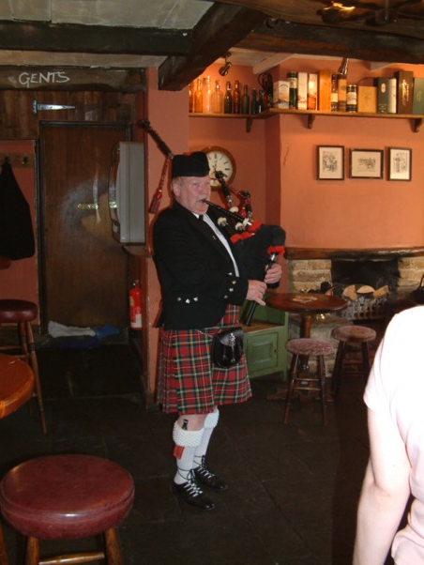
What you have told us
Gastropub
Family-friendly
Community focus

Slide 7
The Future of the Red Lion
The vision and plan for the pub

Slide 8
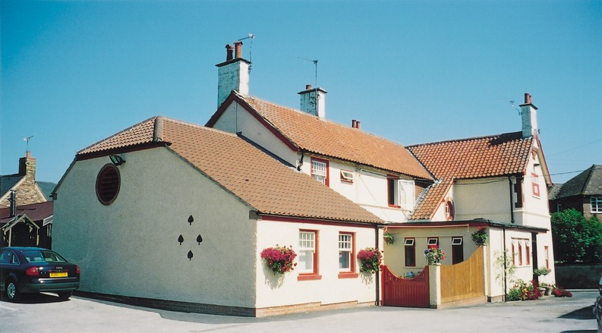
Vision
Our vision for the Red Lion is to create a warm and welcoming community hub, which will provide an innovative and outstanding place in which to socialise and celebrate village life.

Slide 9
What is a Community Benefit Society?
Committee (currently provisional)
Access to grants and loans
Fund raising through Share Offers
Allows normal running of a business
Provides Limited Liability protection

Slide 10
Business Plan
Business Plan
Survey
Financials
Proposition
Business Model

Slide 11
Raising Share Capital
Stock £30K
Renovation £200K
Purchase £350 +

Slide 12
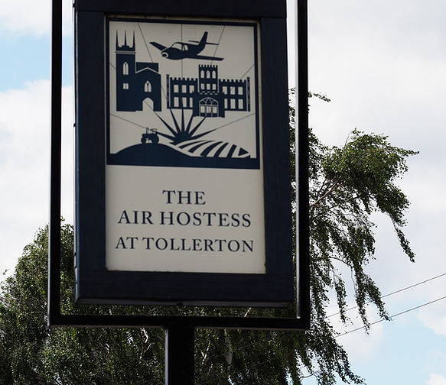
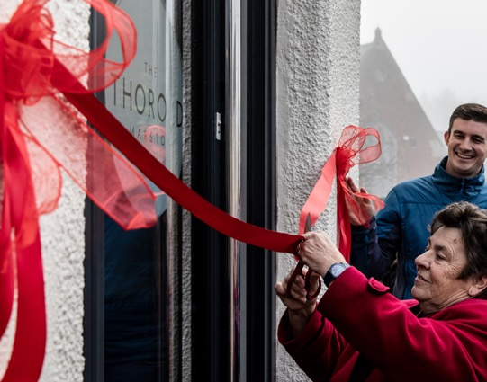
Are Community Pubs successful?
And others?

Slide 13
The Share Offer
What is needed from the community to achieve the vision?

Slide 14
The Share Offer
What are
?

Slide 15
The Share Offer
What are the benefits of Community Shares?
Normal Shares
Community Shares
And the risks?

Slide 16
The Share Offer
How much does a share cost?
£
£50 per share
What is the minimum and maximum?

Slide 17
The Share Offer
December 2021
28 February 2022
New share offer
How long do I have?

Slide 18
The Share Offer
What’s in it for me?
Financial?
Practical
Ownership
Terraced houses?

Slide 19
What you can buy for Christmas……
£250 – cutlery and crockery
£500 – till or bar fridge
£1000 – fire extinguishers
£2500 – intruder alarm and CCTV
£5000 – tables, chairs, bar stools, sofas and artwork or fire alarm system
£10,000 – log-burners, new doors
£20,000 – refitting the kitchen or painting the outside
£25,000 - rewiring

Slide 20
Our Ask Tonight
Support the Red Lion
Support your community for now and the future
Pledge tonight to Save the Red Lion

Slide 21
QUESTIONS?

Slide 22
Please collect some information and chat with us. In 20 minutes we will reconvene to summarise the key points discussed.

Slide 23
Website: www.savetheredlionstathern.com email: RedLionCommunityGroup@gmail.com Facebook: @redlioncommunitygroup

